Slide 1
WELCOME
INFORMATIVE
FUN
EXCITING

Slide 3
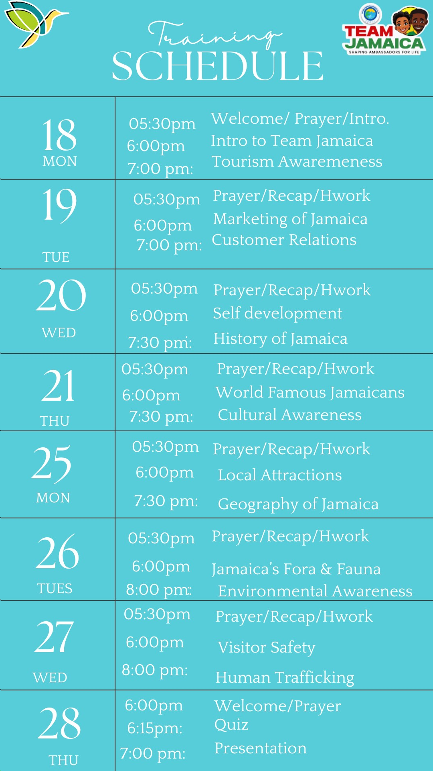
PROGRAMME SCHEDULE

Slide 4
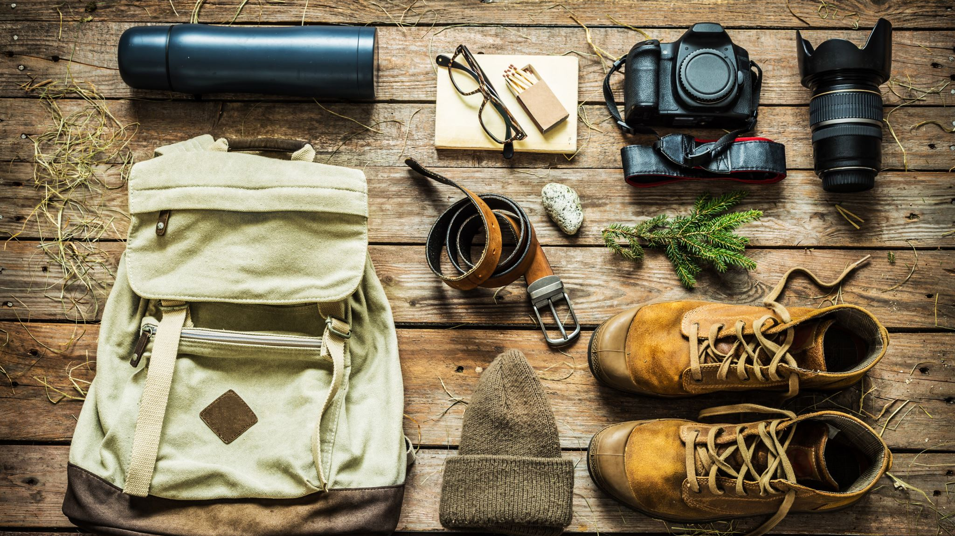
TOURISM AWARENESS

Slide 5
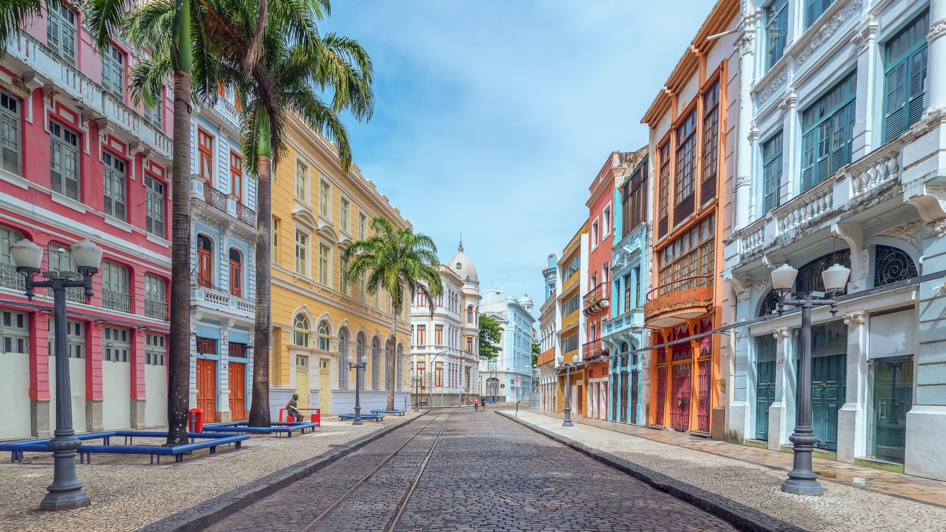
GENERAL OBJECTIVES
To create an understanding of the historical development of tourism in Jamaica
To improve knowledge and understanding of tourism and the tourism sector
To bring awareness of the general principles involved in the marketing of Jamaica as a vacation destination
To identify The Tourism Product

Slide 6
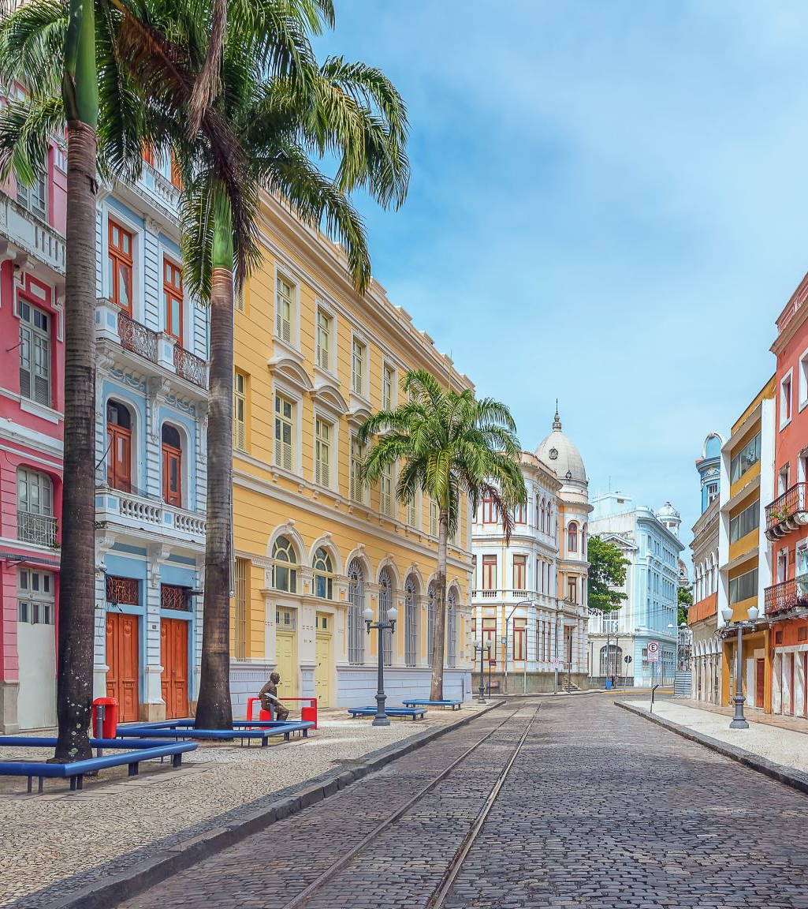
Session Objectives
Explore the motives, mode of travel of the early travelers.
Recall factors which influence the development of tourism in Jamaica
Outline a brief history of Tourism in Jamaica

Slide 7
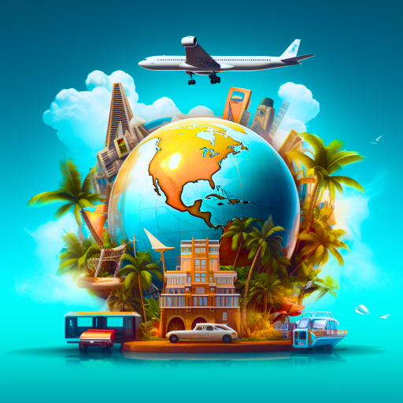
WHY DO PEOPLE TRAVEL ?
If you were given an all-expense vacation, where would you go?
Why would you go there?

Slide 8
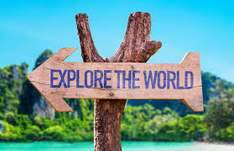
WHAT IS TOURISM?
Tourism comprises :
activities of persons travelling
staying in places outside their usual environment for various purposes
Usually not more than one consecutive year.

Slide 9
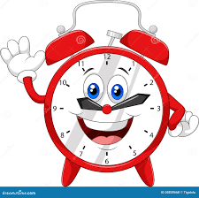
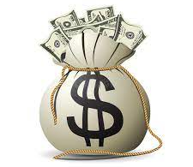
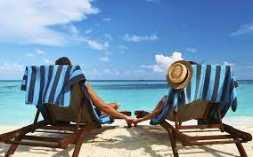
Time
Mobility
Money
Motivation for travel
WHAT IS TOURISM?
In order for tourism to occur the following economic and social conditions must be taken into consideration.

Slide 10
DEFINITION OF TOURISM
The temporary movement of people to
destinations outside their normal places
of work and residence.
The activities they undertake during their
stay and the facilities created by the
destinations to cater to their needs.

Slide 11
Factors Influencing Early Tourism
Wealth from the plantations
Seasonality/Climatic conditions of the region/Jamaica
Triangular Trade Passage
Need for alternative economic activity to replace sugar

Slide 12
History of Jamaica’s Tourism Industry
Where in Jamaica do you think Tourism started?
PORTLAND

Slide 13
History of Portland’s Tourism Industry
Banana Trade – influenced by Captain Lorenzo Baker 1870s
Erection of the Titchfield Hotel in 1897

Slide 14
Loading Bananas, Port Antonio

Slide 15
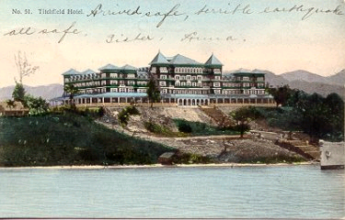
PORTLAND
Titchfield Hotel

Slide 16
EARLY RESORT AREAS

Slide 17
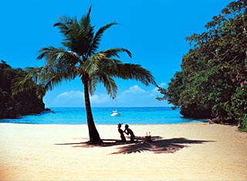
PORT ANTONIO RESORT AREA
1940 -50 Navy Island.
Errol Flynn
FRENCHMANS COVE (1st All Inclusive Hotel- 1962)
BLUE LAGOON
CAVES/MINERAL BATHS
Notes:
Opened in 1962

Slide 18
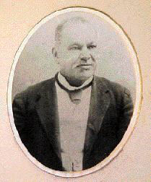
KINGSTON & PORT ROYAL
1890 – The Hotel Law enacted
Indicated Government’s intention to invest in Tourism
1891 – Great Exhibition – 300,000 participants
Investors invited to the island - The Great Exhibition 1891
Showcase – Jamaica's manufactured products Items
Exhibited –rum, spices, khus khus perfume, arts & crafts
Construction of five hotels to accommodate visitors –
3 – Kingston - Constant Spring, Queens /Myrtle Bank

Slide 19
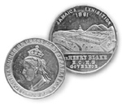
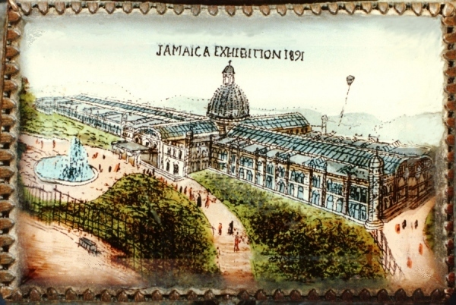
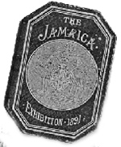
Season Pass for The Great Exhibition - 1891
Special coins were minted for the event. The front carried a picture of the Queen , the back the Exhibition Hall.

Slide 20
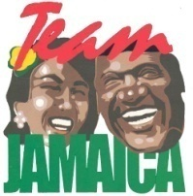

Slide 21
The Myrtle Bank Hotel Harbour Street, Downtown Kingston
1870 – built by Scotsman-James Gall a representative of the Kingston Hotel Company
1944 – purchased by Abe Issa
1969 – demolished by UDC

Slide 22
The Constant Spring Hotel Constant Spring Road, St. Andrew
1st hotel building in Jamaica to have electricity
1888-built by American Hotel company
Rebuilt in 1891
1944 – Franciscan sisters purchased & converted to Immaculate Conception High School

Slide 23
QUEENS HOTEL
Corner of Princess & Heywood Street
Built by Colonel Ward – Benefactor the Ward Theatre
Built for housing working class people at the time of the Great Exhibition
Now demolished

Slide 24
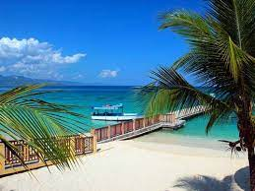
MONTEGO BAY El Golfo de Buen Tiempo (Fair Weather Bay)
1920’s - Advertised as a Health & Pleasure destination
Doctor’s Caves - Popularized by Dr. Herbert Baker and Alexander McCatty for it’s curative benefits and climate.

Slide 25
Montego Bay
Doctor’s Cave
Doctor’s Cave Beach

Slide 26
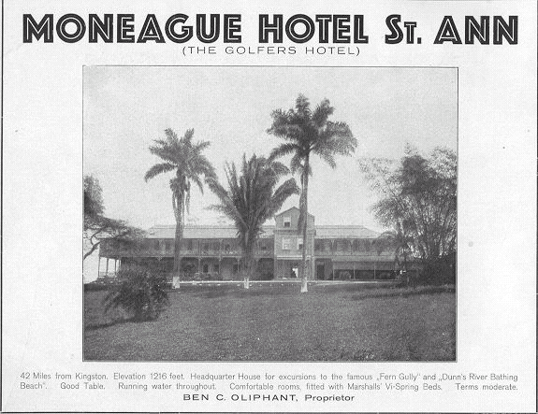
OCHO RIOS
Small fishing village
Tower Isle Hotel
Built by Abe Issa (1948)

Slide 27
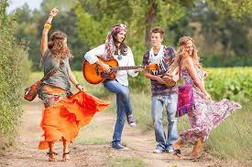
NEGRIL
1960 - Flower Children or Hippies
(Draft dodgers, college kids)
Hippies would rent a room and eat out of the family pot
Base for Soldiers
(Battle of New Orleans 1702)

Slide 28
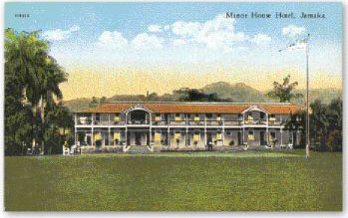
MANDEVILLE HOTEL
1865 – 1st Golf Club in Caribbean
1875 – 1890s - owned by Brooks family
Oldest in the Western Hemisphere
Renamed from Brooks Hotel to Mandeville Hotel

Slide 29
The Town of Falmouth
Caribbean’s best preserved Georgian-historic town.
Founded by Thomas Reid in 1769
Falmouth named after Falmouth, Cornwall in England, the birthplace of Sir William Trelawny the Governor of Jam
Well planned, laid out wide streets with grid
Adequate water supply (Persian waterwheel)- Martha Brae
Had running water before New York City
St Peter's Anglican – land Donated by Edward Barrett designed for 300 – 1000 persons.

Slide 30
FIVE MINUTES

Slide 31
REVIEW
Where did tourism start in Jamaica?
What was the name of the first modern hotel in Jamaica?
In what year was the Great Exhibition held in Jamaica?
Why was the Great Exhibition held in Jamaica?
How many hotels were built for the Great exhibition?
How did Falmouth get its name?

Slide 32
Session Objectives
Define Tourism, Tourism Product
Identify the different categories of Tourism
Explain types of tourism
Explain the benefits/impacts of tourism to the individual and the country

Slide 33
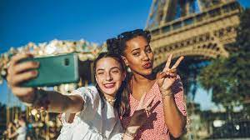
WHO IS A TOURIST?
Any person who visits a country or place for more than twenty four hours but less than a year for a variety of reasons other than employment.

Slide 34
WHAT IS THE TOURISM PRODUCT?
The experiences and memories resulting from taking part in tourism activities.
This begins from the individuals choosing their destinations and ends when they return to their normal place of residence.

Slide 35
CHARACTERISTICS OF THE TOURISM PRODUCT :
Is a comprised of many elements
Intangible
Perishable
Major item of consumer expenditure

Slide 36
CHARACTERISTICS OF THE TOURISM PRODUCT :
Visitor moves to the product
Subejectively consumed
Visitor expectation buildup of product

Slide 37
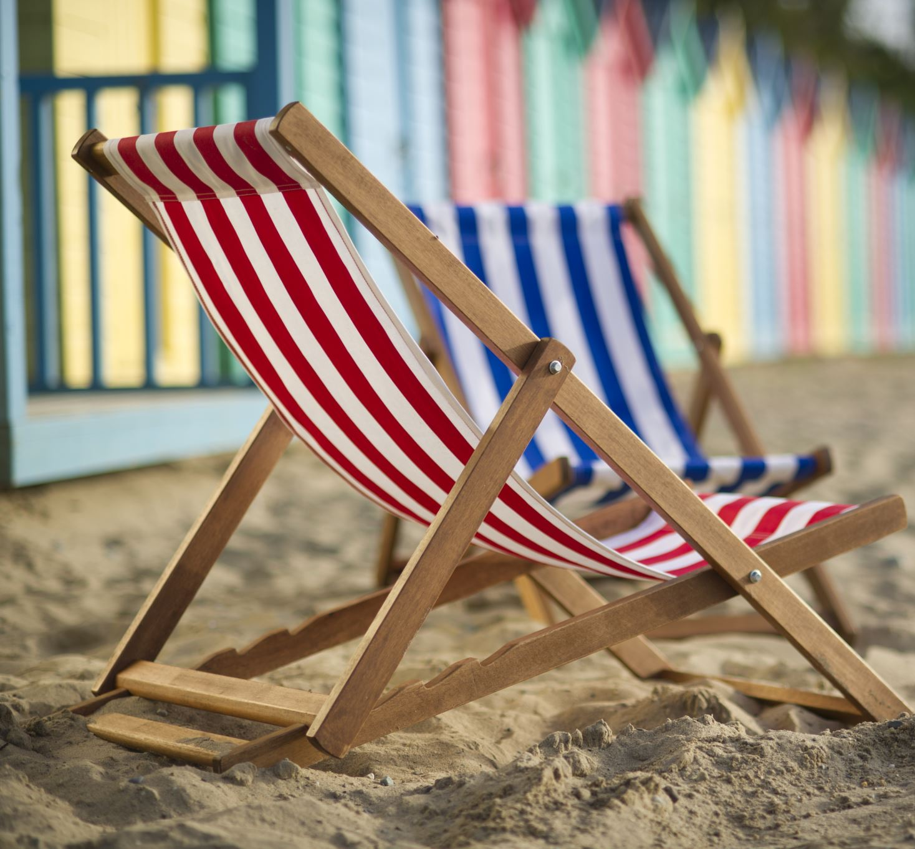
MAJOR ELEMENTS OF THE TOURISM PRODUCT
The tourism product is a combination of the following:
Accommodation
Attraction
Amenities
Accessibility

Slide 38
MAJOR ELEMENTS OF TOURISM PRODUCT
Transportation
Accommodation
Activities and Entertainment
Food and Beverage
Shopping
Supporting Services
(Refer to handbook)

Slide 39
RECALL : True or False
Tourist is someone who visits another place outside of their work and home for a short period for any reason including employment
Tourism Product is tangible
Main elements of tourism product are; accommodation, shopping, airplane, ziplining

Slide 40
TYPES OF TOURISTS

Slide 41
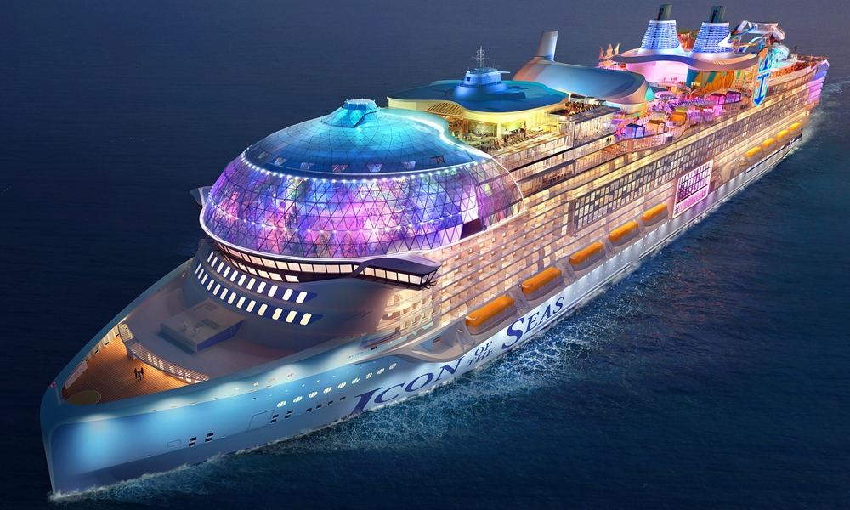
EXCURSIONIST
Day visitor who spends less than twenty four hours in a place visited e.g. Cruise ship passengers.

Slide 42
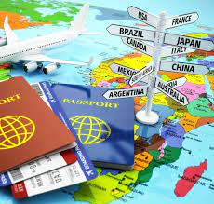
INTERNATIONAL TOURIST
A person who travels outside their defined geographical region for more than 24 hours and less than 1 year.
This should be for a variety of reasons other than employment

Slide 43
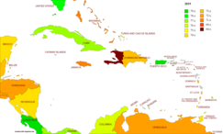
REGIONAL TOURIST
A person who travels within a particular geographical region and stays more than 24 hours but less than a year e.g. Barbados to Jamaica
For a variety of reasons except employment

Slide 44
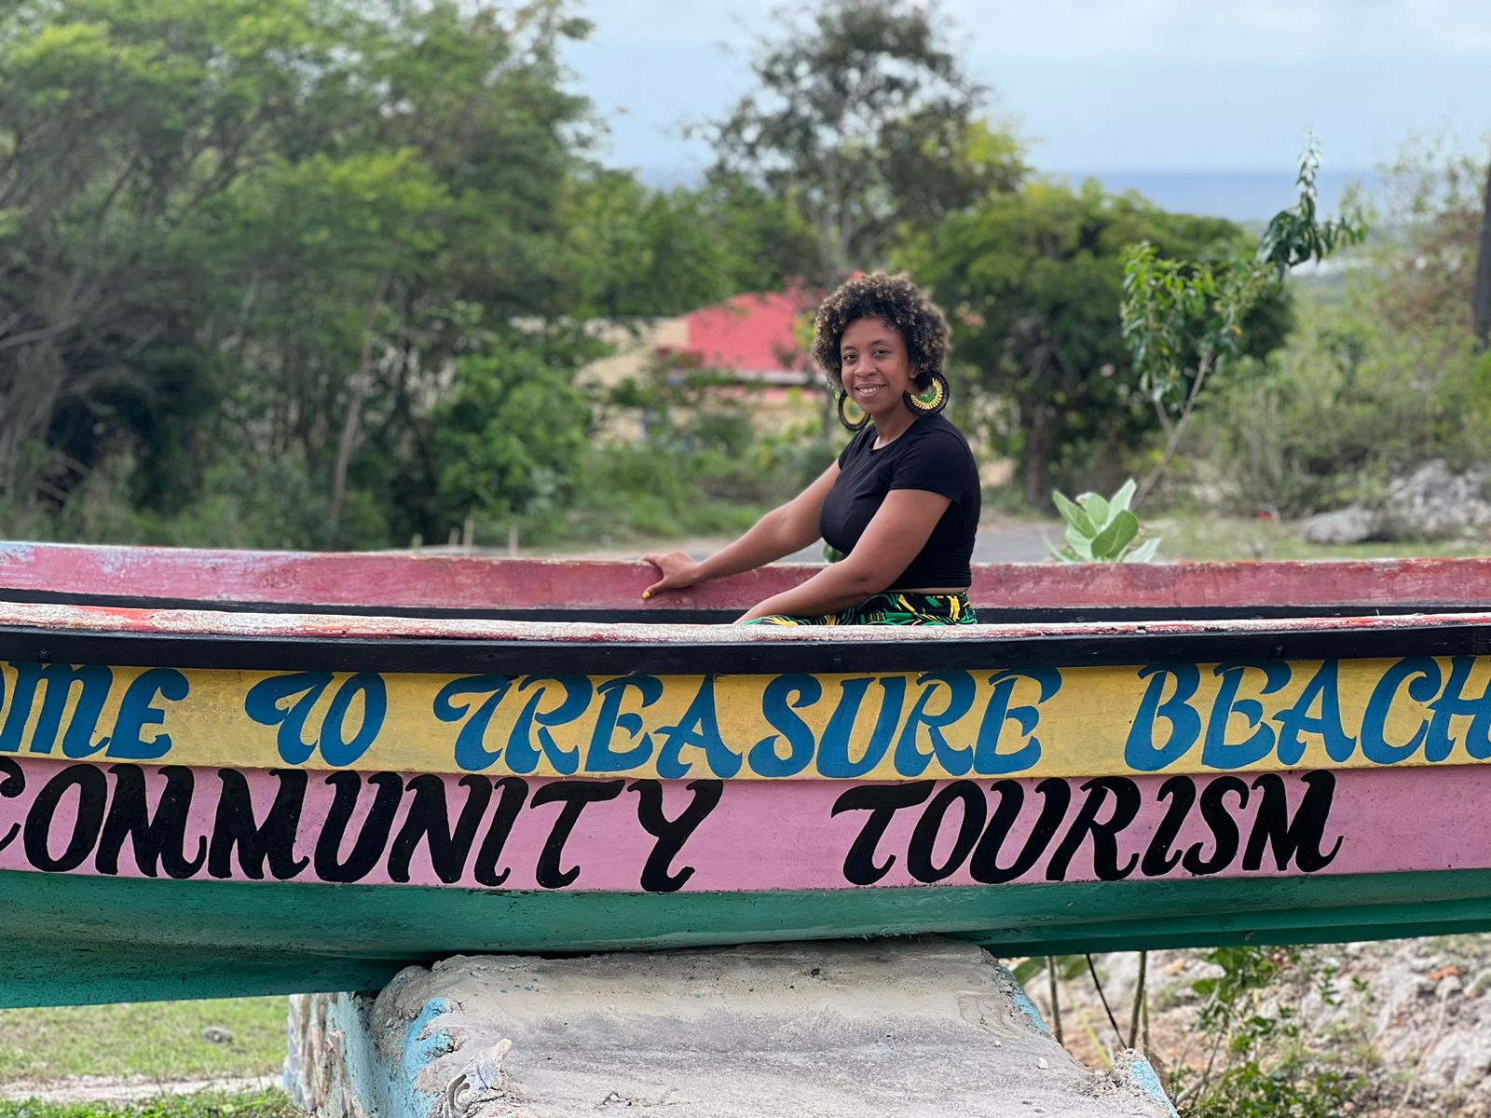
DOMESTIC TOURIST
Persons travelling within their own country for at least one night but less than a year.

Slide 45
CATEGORIES OF TOURISM

Slide 46
CATEGORIES OF TOURISM
Eco Tourism
Cultural Heritage
Special Events
Sports
Cruise
Adventure
Health and Wellness
Culinary
(See handbook)

Slide 47
EXAMPLES
Eco Tourism-
Cultural Heritage-
Special Events-
Sports-
Cruise-
Adventure-
Health and Wellness-
Culinary-
(See handbook)

Slide 48
Give an example of a type of tourist & category of tourism

Slide 49
IMPACT OF TOURISM

Slide 50
TOURISM IMPACT
Economy
Environment
Culture and the Society
(Refer to handbook)

Slide 51
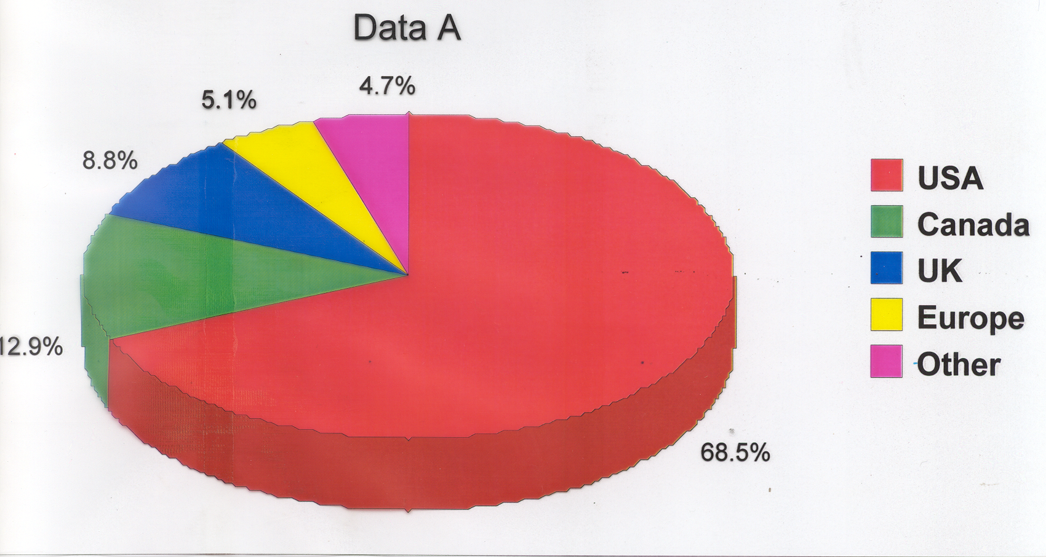
STOPOVER ARRIVALS BY MARKET SHARE

Slide 52
Positive
The effects are welcomed as they are good e.g. contributes to employment
Negative
The effects harms the environment, culture and the society e.g. Environmental degradation
Direct
Money spent by tourists in the country
Indirect
The movement of the tourism dollar through the economy
TOURISM IMPACTS

Slide 53
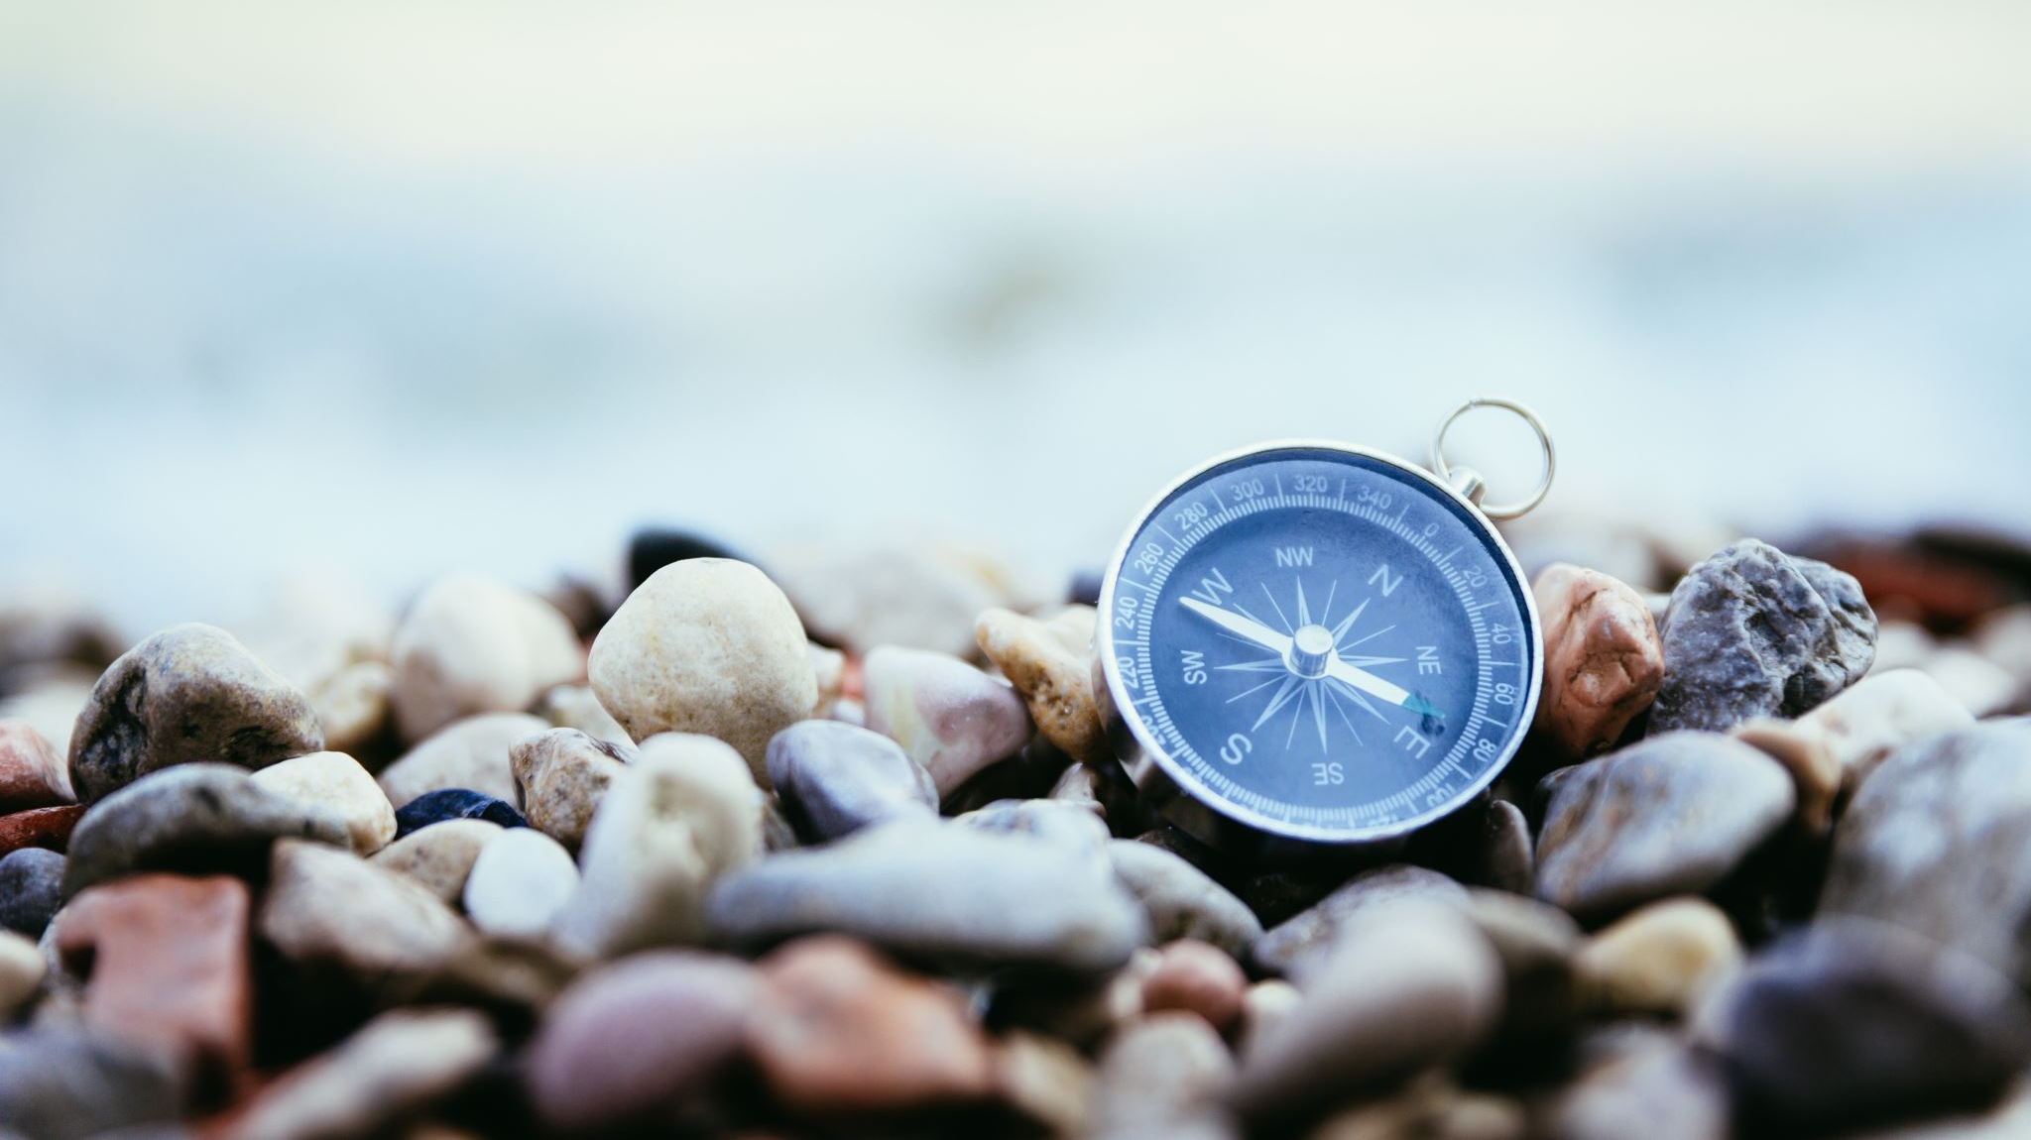
HOW DOES TOURISM IMPACT YOU?

Slide 54
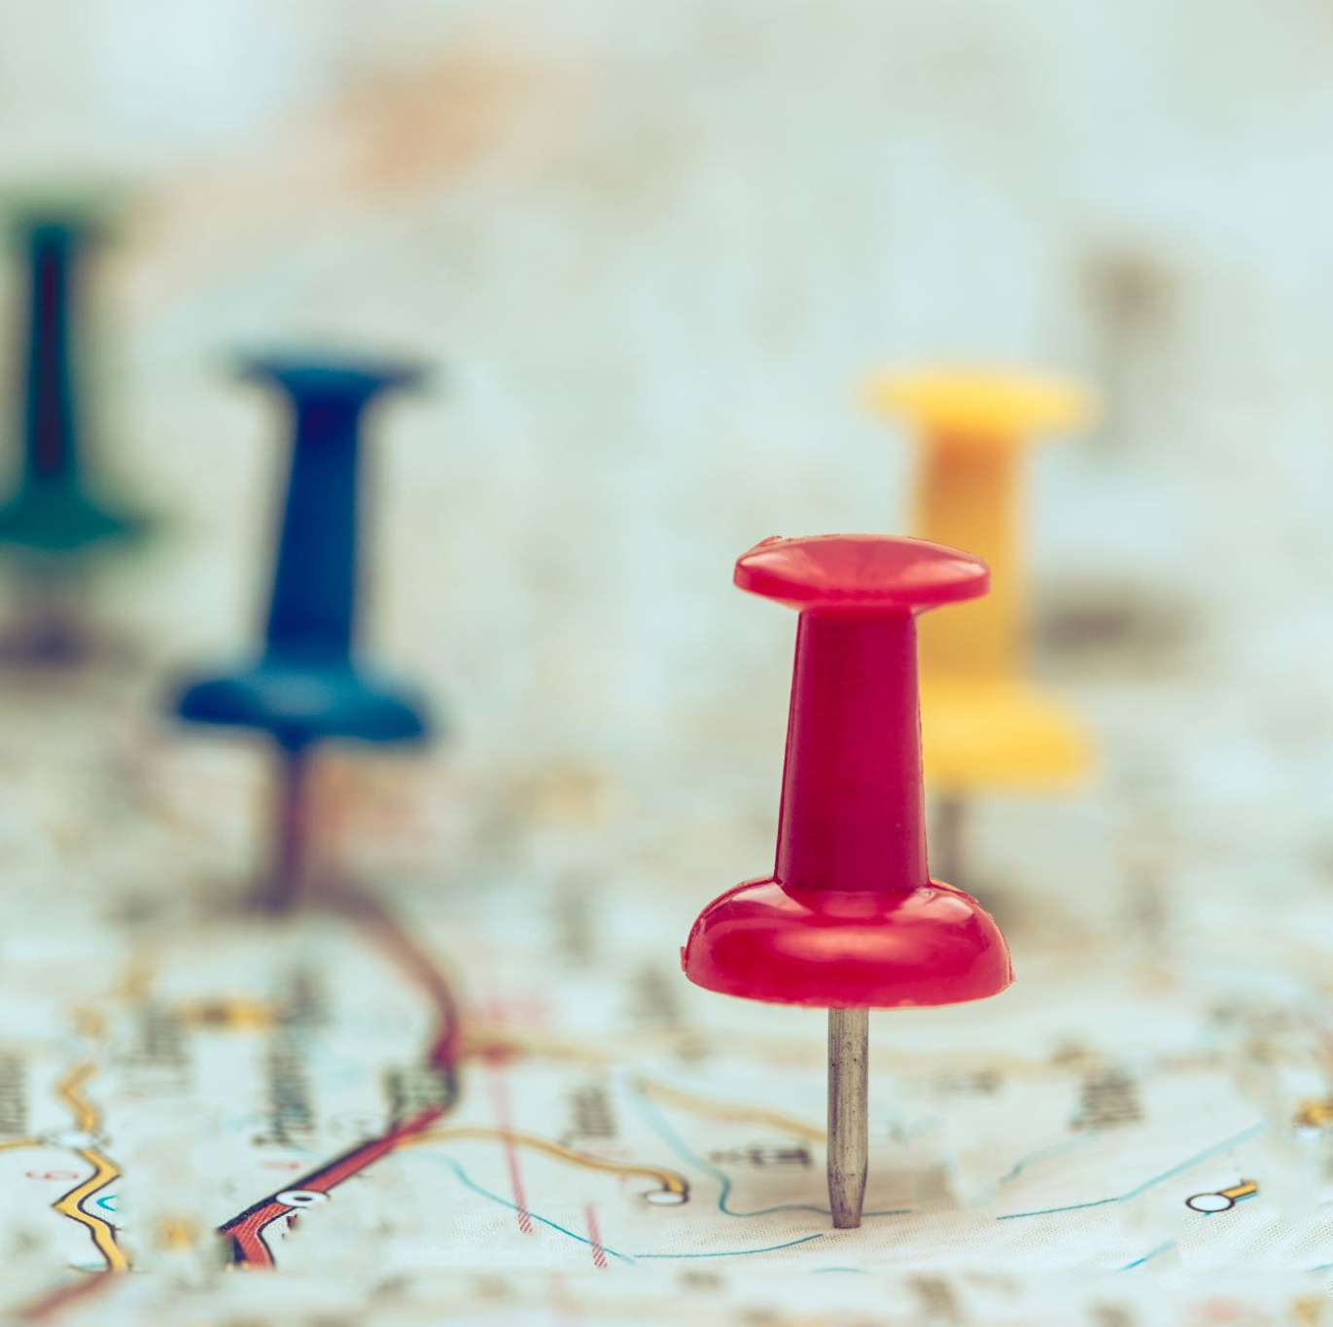
Session Objectives
To identify some trends in Regional and International tourism

Slide 55
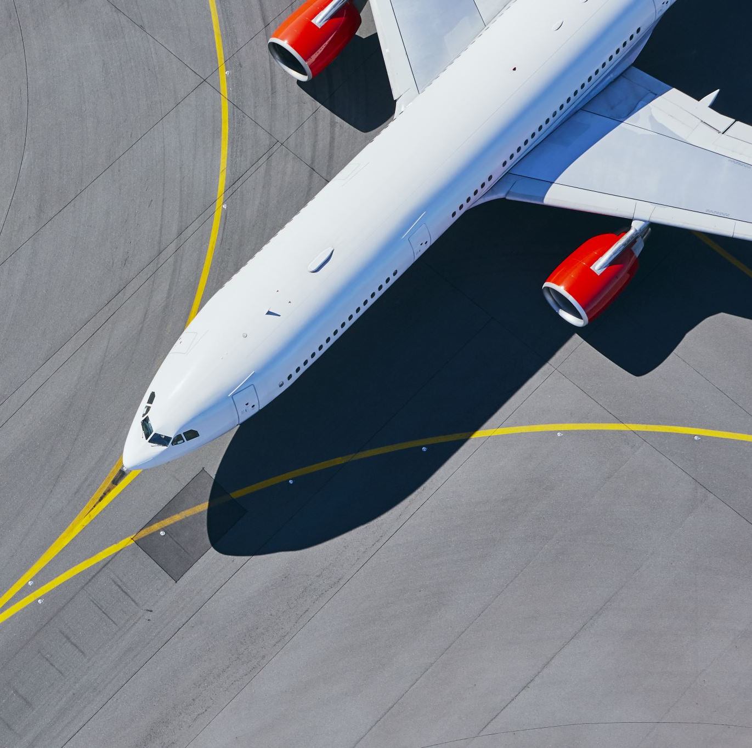
TOURIST/TRAVEL TREND
General tendency or direction of tourist behavior

Slide 56
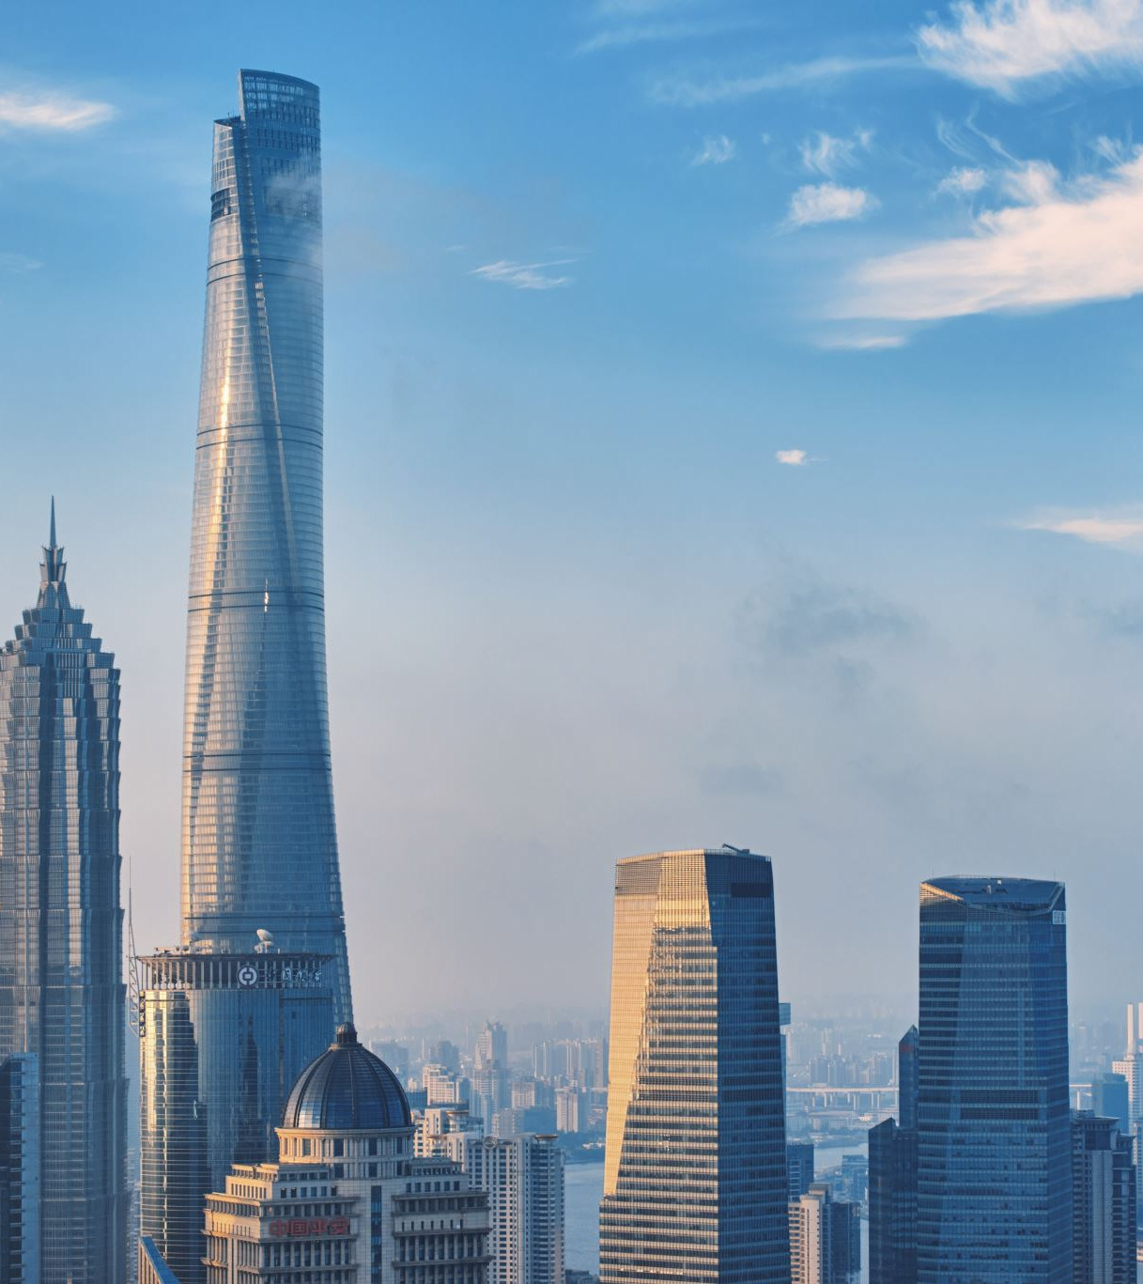
2016 TRAVEL TRENDS
Discovery of untouched or unique places
Millennials Looking for Adventure tourism
Increase in Air Bed & Breakfast travel
Staycation or travelling closer to home
Continued strength of the Chinese Market
Larger cruise vessels – Harmony of the Seas (largest ship)
http://www.trekksof.com/en/blog/travel-industry

Slide 58
2023 TRAVEL TRENDS
Multigenerational/Family Travel
Beach Vacations
Transformative Adventures
High End Travel
Jet Setting/TV Show Recommendations
Environmental Educational Experiences;e.g climate change
Cruises
Domestic Travel
Cultural ( Indigenous/First Nations Travel)
Digitalless Family trips
Wellness Retreats- Off the beaten path
The 15 Travel Trends That Will Define 2023 (travelpulse.com)

Slide 60
NEXT CLASS
Marketing Jamaica

